Slide 1
Multilayer Perceptron

Slide 2
Agenda
Overview of single layer perceptron
Why Multilayer perceptron
Multi layer perceptron model
Numerical Problem based on Multilayer perceptron
Applications

Slide 3

Single Layer Perceptron :Pattern recognition : Pattern 08
00
X₁
w₁
01
02
.
w₂
.
X₂
.
08
w_{n}
X_{n}

Slide 4
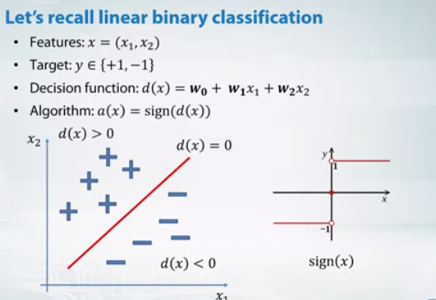

Slide 5
Why Multilayer Perceptron?
Solving Linearly inseparable problem
What is linearly separable?
What is linearly in-separable?
AND operation OR Operation
 | T | F
T | T | F
F | F | F
 | T | F
T | T | T
F | T | F
 | T | F
T | F | T
F | T | F
XOR

Slide 6
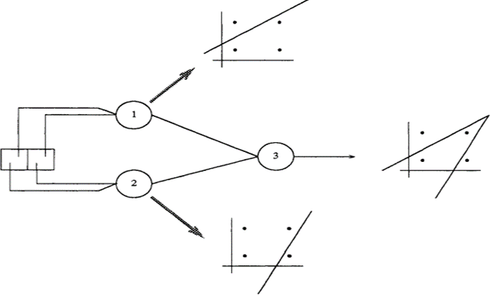
Why Multilayer Perceptron?

Slide 7
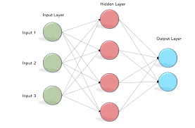
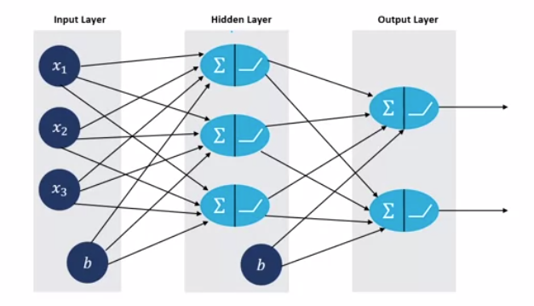
Multilayer perceptron Model

Slide 8
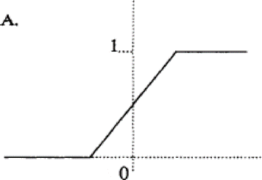
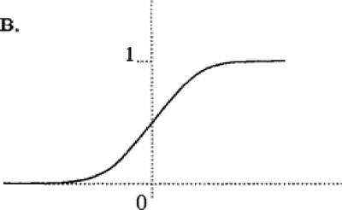
Threshold Function
Linear Threshold (Step Function)
Sigmoidal Threshold
f(net) = 1/(1+e^{-knet})
Multilayer perceptron uses non-linear threshold function called sigmoidal function
Learning rule in Multilayer perceptron is called “Back Propagation Rule”

Slide 9
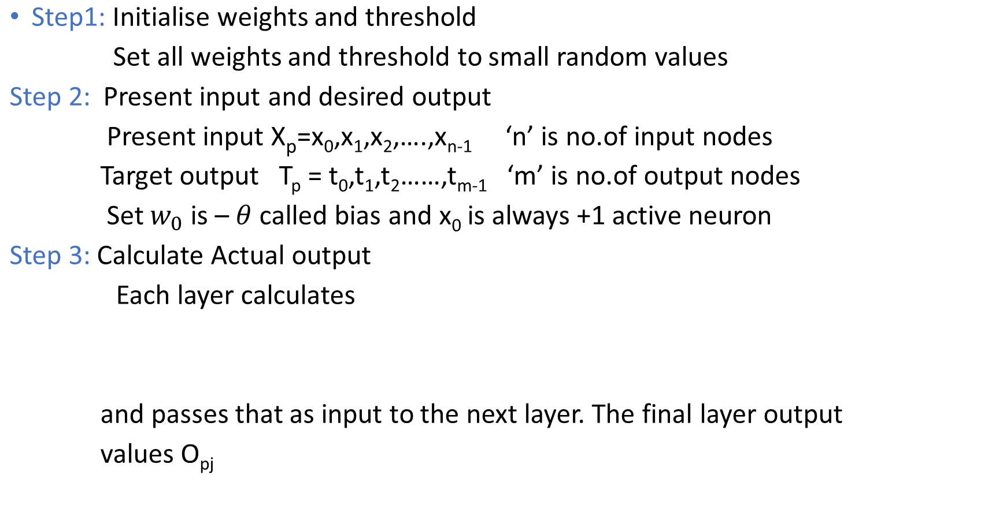
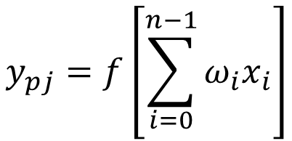
Multilayer Perceptron Algorithm

Slide 10
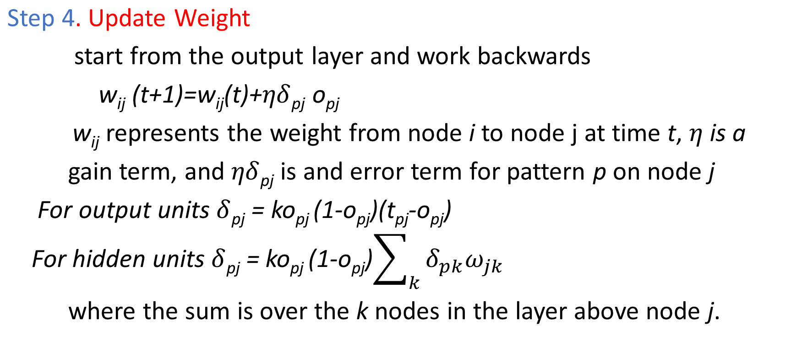
Multilayer perceptron algorithm

Slide 11
Example
Given Data:
In a given multilayer feed-forward neural network.
Learning rate be 0.9.
The initial weight and bias values of the network are given in Table 1, along with the
First training tuple, X= (1, 0, 1),
With a class label of 1 (target value Tj).
This example shows the calculations for backpropagation, given the first training tuple, X. The tuple is fed into the network, and the net input and output of each unit are computed. The error of each unit is computed and propagated backward. The error values and the weight and bias updates are calculated.

Slide 12

Initial input, weight and BIAS values
X1 X2 X3 W14 W15 W24 W25 W34 W35 W46 W56 θ4 θ5 θ6
1 0 1 0.2 -0.3 0.4 0.1 -0.5 0.2 -0.3 -0.2 -0.4 0.2 0.1
1
X₀
X1
θ₄
w14
w15
4
w46
w24
X2
2
6
w25
w56
θ₆
w34
5
w35
X₀
X3
3
θ₅
X₀

Slide 13
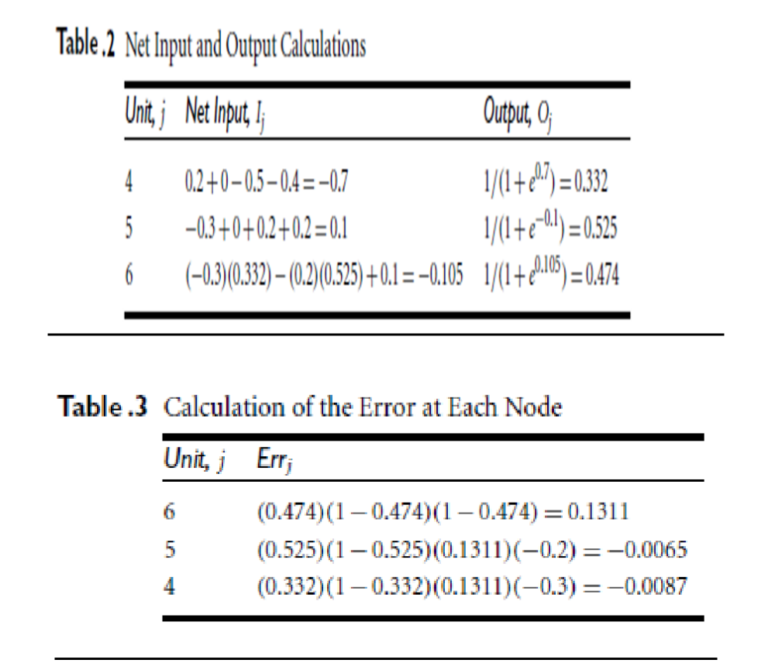
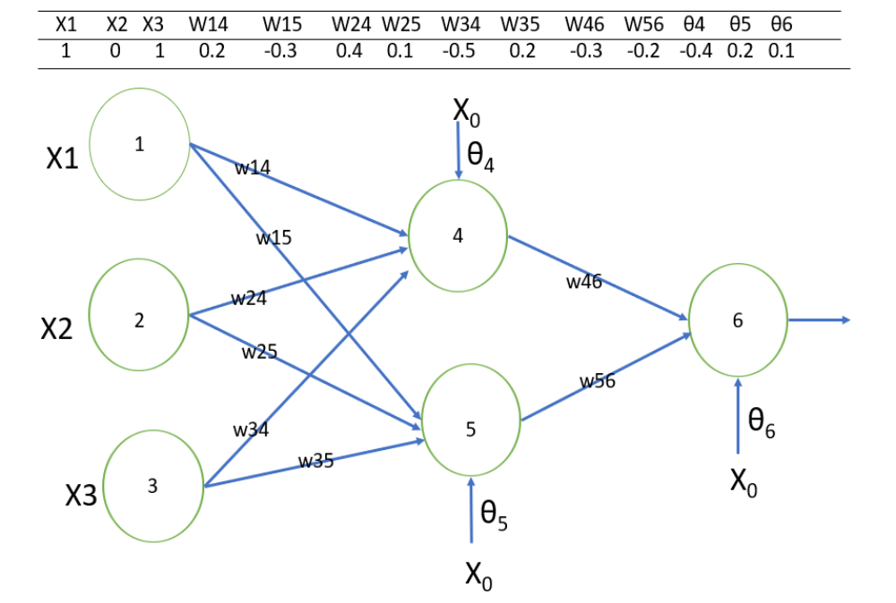
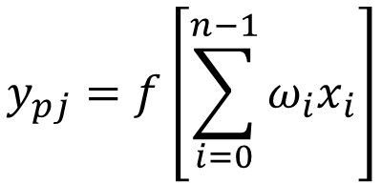

Slide 14


Error Calculation

Slide 15
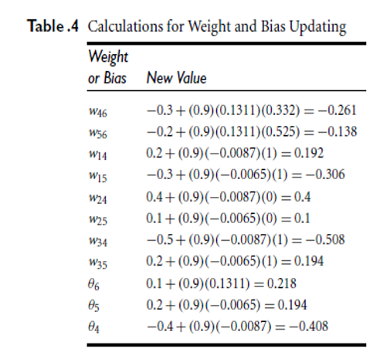
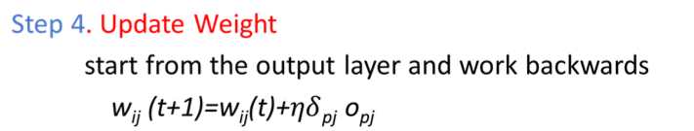

Slide 16
THANK YOU

